Slide 1
Air Quality Monitoring
Breathing Safely
Subtitle: An Overview of Air Quality and Monitoring Techniques
Swetha S (Leader)
Vijayalakshmi S
Meera S
Kaviya V
Keerthika E
Sivajothi R

Slide 2
Abstract
Air quality monitoring is a critical practice in today's world, driven by the increasing concerns over its profound impact on human health and the environment. This presentation explores the fundamental aspects of air quality monitoring in a 10-slide format

Slide 3
Introduction
Briefly introduce the concept of air quality and its importance.
State the objectives of the presentation.

Slide 4
Air Quality Monitoring - Breathing Safely
Air quality is a fundamental component of our daily lives, impacting both our well-being and the environment we inhabit. This presentation delves into the world of air quality monitoring, exploring its significance in safeguarding our health and the planet

Slide 5
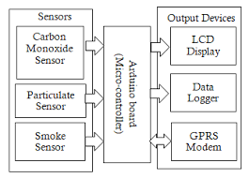
Block Daigram

Slide 6
Conclusion
on
Summarize key points from the presentation.
Emphasize the importance of monitoring and improving air quality.
Thank your audience for their attention and provide contact information for further inquiries.

Slide 7
THANK YOU

